Slide 1
HACKINDIA SPARK-12 · JAIPUR
Policy Pulse
An AI Assistant that Helps People Find Government Welfare Schemes
Team Name: 404 not found Team Leader: Hariansh Singhal
Problem Statement: Build an AI tool that makes it easier for people to find government information, schemes, and services.

Slide 2







HACKINDIA SPARK-12 · JAIPUR
POLICY PULSE
Context
STATUS QUO
OBJECTIVE
TARGET AUDIENCE
Universal Access — bridge the gap between policy intent and citizen benefit. Absolute Trust — give clear answers backed by real, official sources.
Information Silos: Scheme details are scattered across 50+ different government websites.
Rural
Population
Feature Phone
Users
Small
Merchants
Remote
Regions
Help
Centres
Language Exclusion: Notices are written in complex, formal English.
SOLUTION
The Innovation: An AI system that turns complicated government notices into simple, accurate answers. The Promise: Reaches every citizen through voice, in their own language, on any device — even basic phones.
Eligibility Maze: Eligibility rules are buried in long PDF files that are hard to search.
Why Now? With smartphones and Aadhaar now widespread across India, a voice-first AI system like this is finally possible at national scale.
Static Search: Basic keyword search can't understand what people really mean, like “help for farmers”.
Reality Check: ~₹80,000 Cr in welfare funds go unclaimed annually.
02

Slide 3









HACKINDIA SPARK-12 · JAIPUR
POLICY PULSE
Solution
FEATURE | General LLMs | Govt. Portals (UMANG) | POLICY PULSE
Reliability | Can invent wrong facts | Official documents | Fact-checked logic
“Why Not” Logic | Vague, generic advice | No explanation provided | Tells you exactly why
Audit Trail | Untraceable answers | N/A (static links) | Every answer shows its source
Last-Mile Access | Needs high-speed internet | App/Website only | SMS and Voice optimized
THE RESOLUTION LOOP
Ask Naturally
User says in Hindi via voice – “mujhe kheti ke liye paise chahiye”
Instant Match
System scans 1000+ schemes. Found: PM KISAN Samman Nidhi
Verify Rules
Checks your details – land under 2 hectares? ✅ Yes
UNIQUE SELLING PROPOSITIONS
“Why Not” Engine – Clearly explains why you do or don't qualify.
Native Multilingual – Works naturally in 10+ Indian languages.
Actionable Answer
You are eligible for ₹6000/year
Retrieval-Grounded – Every answer is backed by an official source.
Omnichannel Access – Works via Web, WhatsApp, SMS, Voice.
Drift Detection – Keeps track of rule changes over time.
03

Slide 4



HACKINDIA SPARK-12 · JAIPUR
POLICY PULSE
Features
THE COGNITIVE PIPELINE
INPUT LAYER
PROCESSING LAYER
OUTPUT LAYER
The Senses
The Brain
The Voice
Multi Format Ingestion
Reasoning Engine
Action Layer
Reads official documents, news, and voice input, then automatically cleans up the Hindi or English text.
Finds the right policy for your question, checks if you qualify based on age, income, and other details, and flags outdated rules.
Turns the result into a simple Yes/No answer, sent via Web, WhatsApp, or SMS in your language.
Key Tech: OCR / Speech-to-Text
Key Tech: Semantic Search + Rule Logic
Key Tech: API Wrapper / SMS Interface
04

Slide 5





HACKINDIA SPARK-12 · JAIPUR
POLICY PULSE
Workflow
ARCHITECTURE PRINCIPLES
1
2
3
4
5
Input and Ingestion
Query Translation
Scheme Discovery
Eligibility Check
Response Delivery
Takes in your question (voice or text) and official documents.
Translates your question into English for accurate matching.
Finds the right policy, along with its source.
Checks your details against the rules.
Translates the answer back into your language.
Serverless-First, AI-Native, Privacy Preserving, Retrieval-Grounded, Built to work even on slow 2G/3G networks.
05

Slide 6
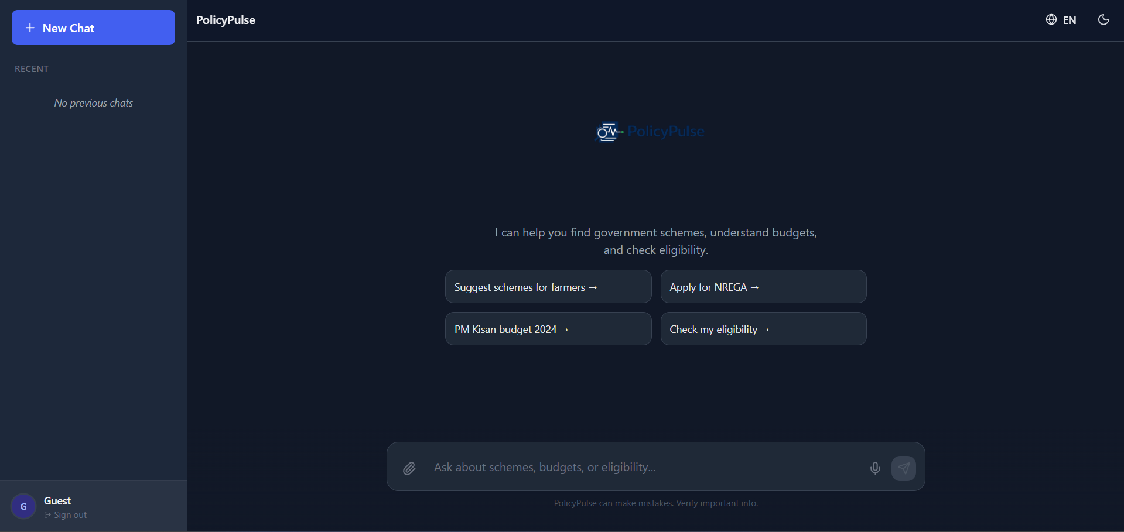
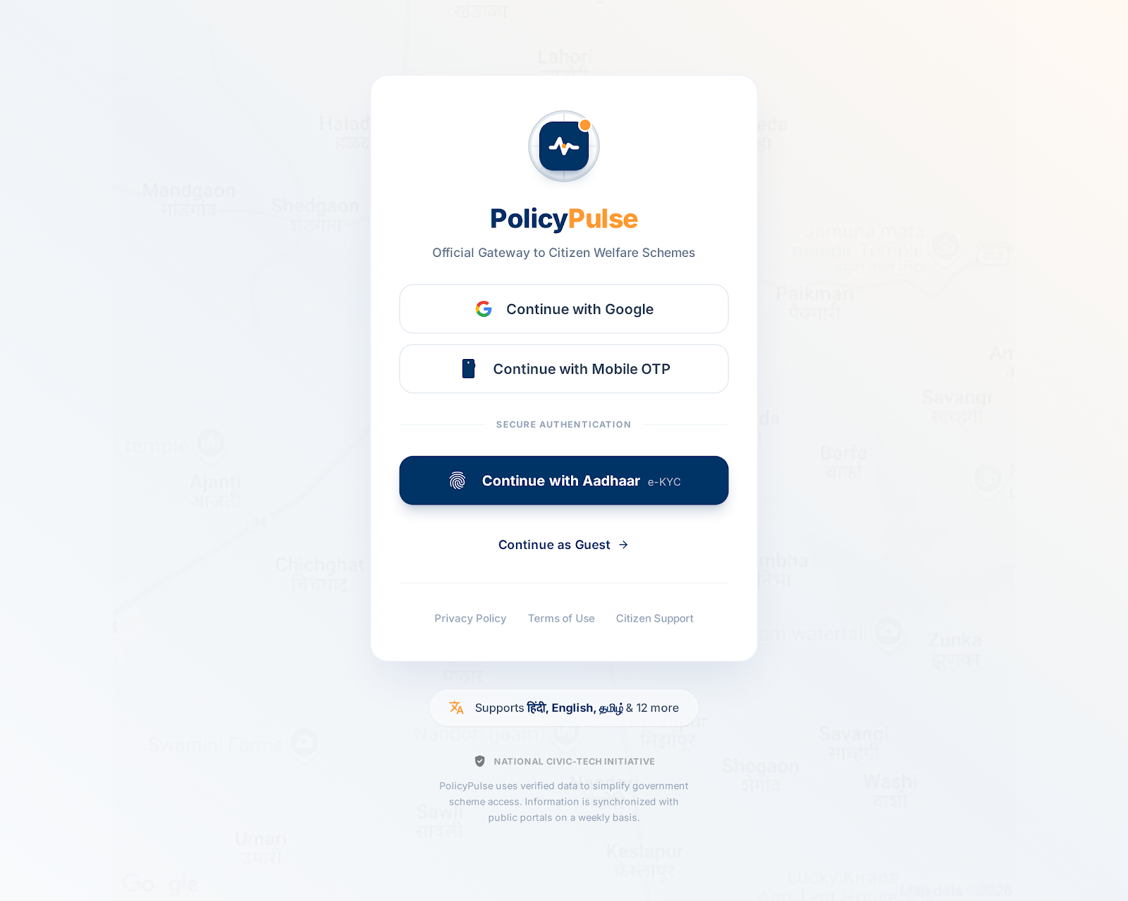
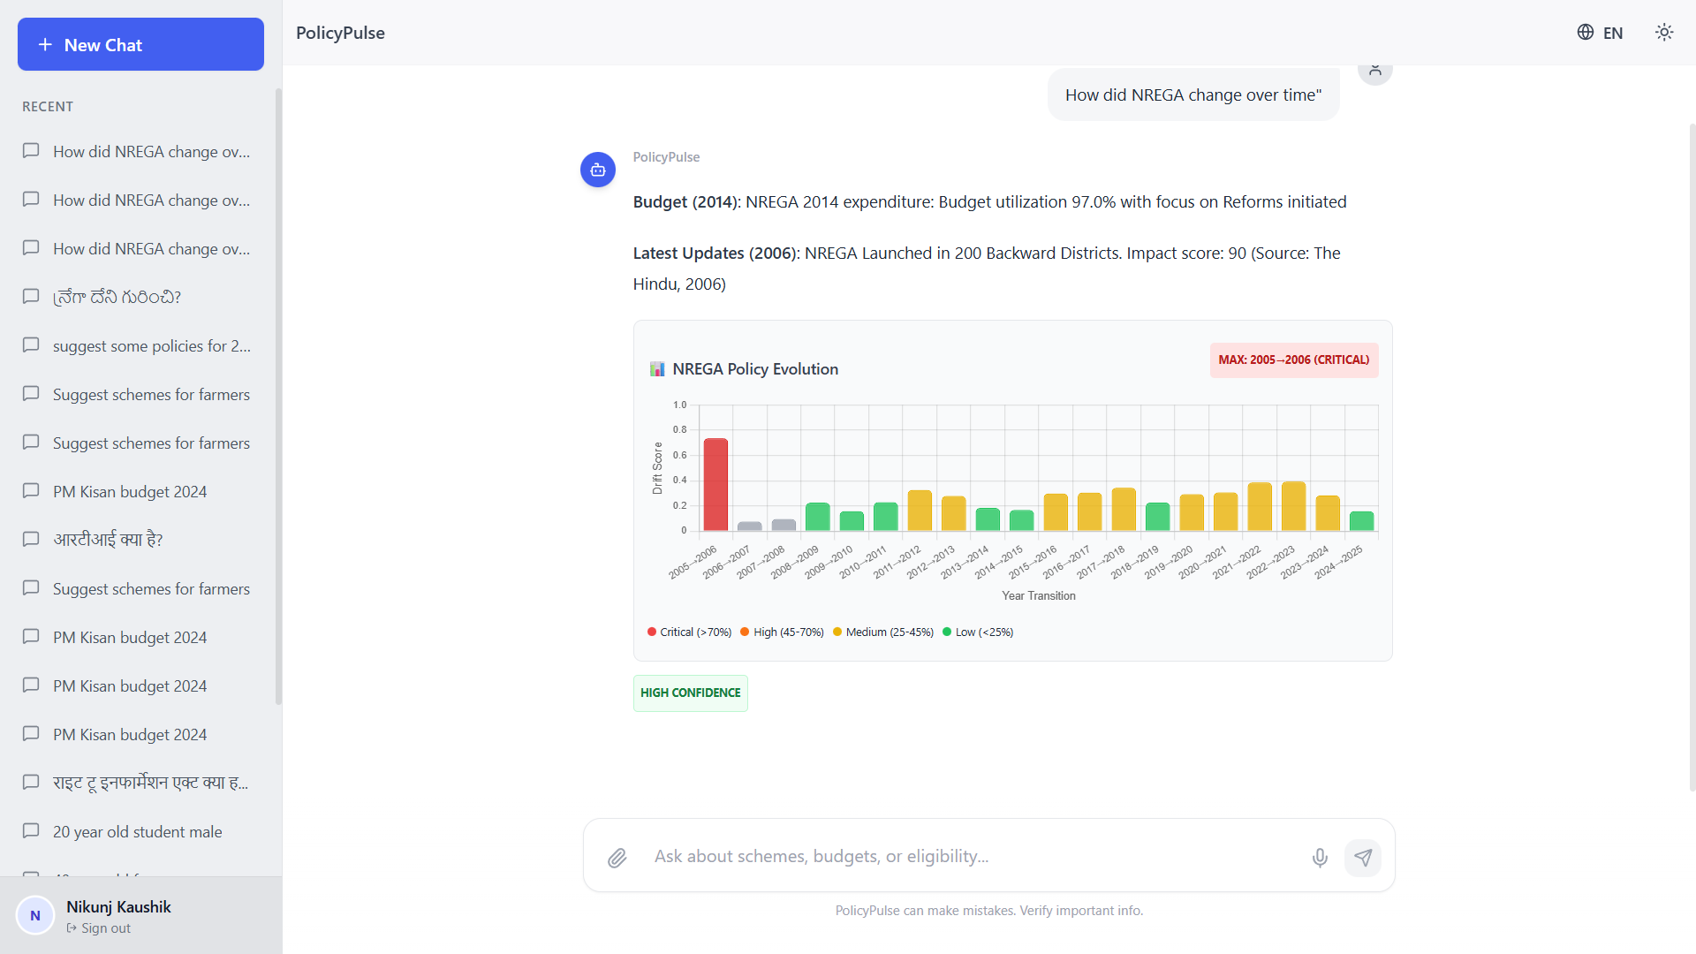
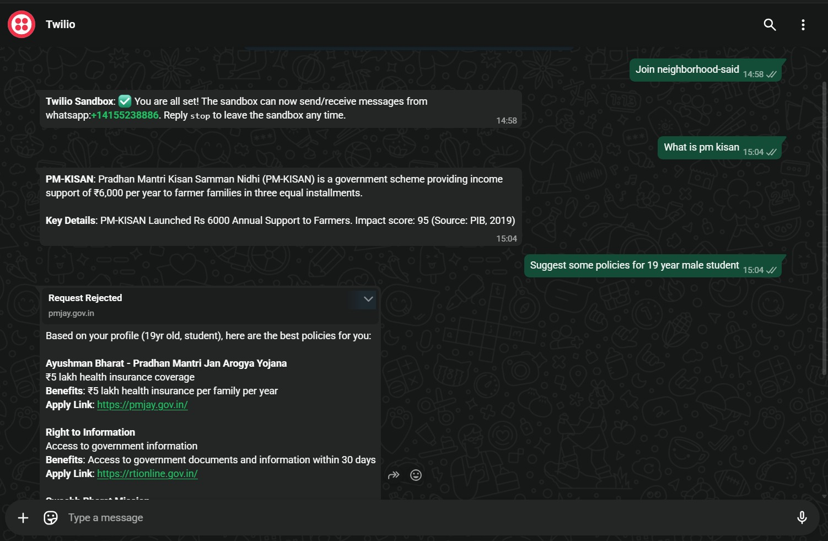
HACKINDIA SPARK-12 · JAIPUR
POLICY PULSE
Interface
Login Page
Main Interface (Dark Theme)
Query Response
WhatsApp Integration
Simple, secure sign-in with Google, phone OTP, or Aadhaar — no app-store dependency.
Left sidebar shows previous chat sessions for continuity.
Cited, chart-backed answer with Drift Detection delivered under 2.7 seconds.
Same assistant, zero-install, reachable on any feature phone.
*Interface screenshots are illustrative concept renders for this submission.
06

Slide 7








HACKINDIA SPARK-12 · JAIPUR
POLICY PULSE
Architecture
User Channels
Orchestrator
Traceability
Security Layer
Website, WhatsApp, SMS
Amazon API Gateway
Amazon CloudWatch
Amazon Cognito, IAM
Voice or Text
Routes traffic · session context
Audit logs · latency monitoring
Auth · session management
Ingestion Layer
Vector Store
Reasoning Engine
Governance
Amazon Transcribe
Amazon DynamoDB, Lambda
Amazon Bedrock, Claude 4.5
Amazon QuickSight
Audio→Text · Regional→English
Scheme embeddings · fast search
Validates eligibility rules
Most-searched · policy-gap detection
Delivery Layer
Amazon SNS
Eligibility Yes/No · formatted in local language
End-to-end serverless pipeline: your voice or text goes in, and a verified, source-backed answer comes out in your language — in under 2.7 seconds.
Model: Claude 4.5 Sonnet on Amazon Bedrock, Amazon Q Compute: AWS Lambda (Python) — zero idle cost, scales instantly
07

Slide 8
HACKINDIA SPARK-12 · JAIPUR
POLICY PULSE
Stack
COMPONENT | SELECTED TECH | STRATEGIC BENEFIT | ALTERNATIVE (WHY NOT?) | EST. COST/MO
Reasoning Core | Amazon Bedrock (Claude 4.5 Sonnet) | Highest accuracy on ambiguous legal criteria. | Llama 3 — risk of hallucination in govt data. | ₹290
Vector DB | Amazon DynamoDB | Massive cost savings; scale-ready via Zero-ETL to OpenSearch. | OpenSearch Serverless — ₹29,000/mo, 1400x more. | ₹21
Compute | AWS Lambda (Python) | Zero idle cost; scales to 1M queries instantly. | EC2 — wasted budget on 24/7 idle servers. | ₹4
Voice / Input | Amazon Transcribe | Native Indian dialect support. | OpenAI Whisper — data sovereignty concerns. | ₹125
Embeddings | Titan Text v2 | 1536-dim vectors optimized for semantic search. | Pinecone — adds vendor complexity & latency. | ₹8
App and Logic | React + Python (FastAPI) | Cross-platform UI + async performance. | Flutter/Node.js — Python libs are superior for AI. | ₹0
TOTAL MONTHLY MVP: ~₹830
PRODUCTION COST (EST.): ~₹62,000 (₹0.06 per query)
All components are pay-per-use, serverless AWS services chosen to keep marginal cost near zero at scale.
08

Slide 9





HACKINDIA SPARK-12 · JAIPUR
POLICY PULSE
Impact
IMPACT ANALYSIS
100%
₹80,000 Cr
300M+
2.7 sec
Trust & Transparency
Economic Velocity
Social Equity
Time Efficiency
Every answer includes a source, so there's no misinformation.
Helps people claim more of the ₹80,000 Cr that goes unused every year.
Makes government help accessible to non-English speakers too.
Cuts a 45-minute manual search down to just seconds.
Infrastructure Model: Policy Pulse can be reused by any state government and easily expanded to cover new schemes.
09

Slide 10
Thank You
Policy Pulse — HackIndia Spark-12, Jaipur
Team 404 not found · Hariansh Singhal

